Slide 1
Every upgrade,
in the right order
NOCO Asset IQ
HVAC
Envelope
LED
A concept by Axion Dynamics, prepared for NOCO
Notes:
0:00 (10 sec). Introduce yourselves. "This is NOCO Asset IQ. It answers one question for a building owner: which upgrades, and in what order?"

Slide 2
A 32-year-old rooftop system in Buffalo needs replacing
$600,000 budget
High-efficiency HVAC
$430,807 net
$172,000
$19,113
22.5 years
a year on energy, in a sample 85,000 sq ft office
saved each year by replacing the HVAC alone
payback on the HVAC alone
Notes:
0:10 (20 sec). "Here's a sample office in Buffalo. It spends $172,000 a year on energy, and its rooftop system is 32 years old. Replacing that system alone costs $430,807 and saves $19,113 a year. The owner has $600,000 to spend. So what should they do?"

Slide 3
Replace it first, and the full plan breaks the budget
$600,000 budget
High-efficiency HVAC
$430,807
Envelope
$77,067
LED lighting
$108,375
$616,249
$16,249
#6 of 6
net cost with HVAC first
over the $600,000 budget
the worst possible order for these three upgrades
Notes:
0:30 (20 sec). "Add lighting and envelope work to that. If the HVAC goes in first, it's sized for the building as it is today, and the plan costs $616,249. That's $16,249 over budget. Of the six possible orders for these upgrades, this one ranks last."

Slide 4
Fix the load first, and the same upgrades fit
$600,000 budget
LED lighting
$108,375
Envelope
$77,067
High-efficiency HVAC
$393,893
$579,335
$36,915
$69,476
net cost with the load fixed first
off the HVAC, sized to the smaller load
more 15-year value than the worst order
Notes:
0:50 (25 sec). Pause as the blocks move. "Same three upgrades. Do the lighting and envelope first and the building needs less heating and cooling, so the HVAC gets smaller. That takes $36,915 off the equipment. The plan now fits, at $579,335, and over 15 years it's worth $69,476 more than the worst order."

Slide 5
Asset IQ tests every order of every combination
LED lighting
Envelope
HVAC
Controls
Rooftop solar
31
325
4
combinations of five upgrades
orderings simulated against the budget
best plans, one for each goal
Each phase saves only from the load the last one left. A simple sum claims $50,014 a year; with the overlap removed, it's $47,627.
Notes:
1:15 (20 sec). "Nobody has to guess the order. Asset IQ simulates all 325 orderings of these five upgrades against the owner's budget, and each phase only saves from the load the last one left, so nothing gets counted twice. Then it offers the best plan for each of four goals."

Slide 6
12.2 years looks bad, but the HVAC was due anyway
Replacing the HVAC alone
$430,807, saving $19,113 a year
The plan adds $148,527
saving $28,514 more a year
5.2 years
12.2 years
payback on the spend beyond replacing the HVAC
plain payback on the whole plan
Notes:
1:35 (25 sec). Say this before they do: "12.2 years is the plain payback on the whole plan, and on its own that wouldn't sell. But this HVAC is 32 years old. That money gets spent either way. The real decision is the extra $148,527, which saves $28,514 more a year. That pays back in 5.2 years."

Slide 7
Now pick any order and watch what it's worth
01 LED lighting
#1 of 6
02 Envelope
this order, the best that fits the budget
03 High-efficiency HVAC
−$69,476
the 15-year cost of the worst order, which also goes $16,249 over budget
Open the live demo
Notes:
2:00 (60 sec, hard limit). Before the talk, open the live app in a browser, go to Strategy > Why this order and scroll to the Order Lab, so you can Alt+Tab straight to it. The button on this slide also opens the demo link, but that starts on Choose a path. Click Worst order and say nothing for a moment. Then: "Same three upgrades, $69,476 worse, and now over budget." Offer the controls: "Pick any order." Alt+Tab back to carry on.
If the internet fails: type 11 and press Enter to jump to the hidden backup screenshot, then type 8 and press Enter to come back.

Slide 8
One assessment can become a staged series of jobs
Year 1
LED lighting
A small first phase gives the customer a reason to start
The roadmap gives them a reason to come back
It reaches the owner before a single-equipment quote does
Year 2
Envelope
Three
Year 3
High-efficiency HVAC, sized to the smaller load
phases, not one quote
Notes:
3:00 (25 sec). "For NOCO, this could change the sales conversation. One building's data becomes a staged series of jobs instead of a single quote: a reason to start small, a reason to come back, and it reaches the owner before a competitor's equipment quote does."
Don't claim NOCO delivers every phase unless you've confirmed its service list. One year between phases is a model assumption.

Slide 9
It's a screen, not an audit. Your data makes it real
Where it stands
What makes it real
Most costs come from public studies, and each is graded
HVAC pricing per ton is the weakest cost
Savings factors are engineering judgement, not yet calibrated
Calibrate on NOCO's completed projects
Add real tariffs and incentive programs
Model fuel switching and failure risk
Pilot with the sales team
Notes:
3:25 (25 sec). Name the weakness before they do. "This is a pre-audit screen, not an audit. The costs have sources, but our savings factors are judgement, and they haven't been calibrated against measured buildings. Your completed projects are exactly what would fix that, and that's what we'd like to do next."

Slide 10
Every upgrade,
in the right order
NOCO Asset IQ
LED
Envelope
HVAC
lavya-gohil.github.io/noco-pathfinder
Notes:
3:50 (10 sec). "Every upgrade, in the right order. We'd love to calibrate it on your projects. Thank you." Stay on this slide for questions.

Slide 11
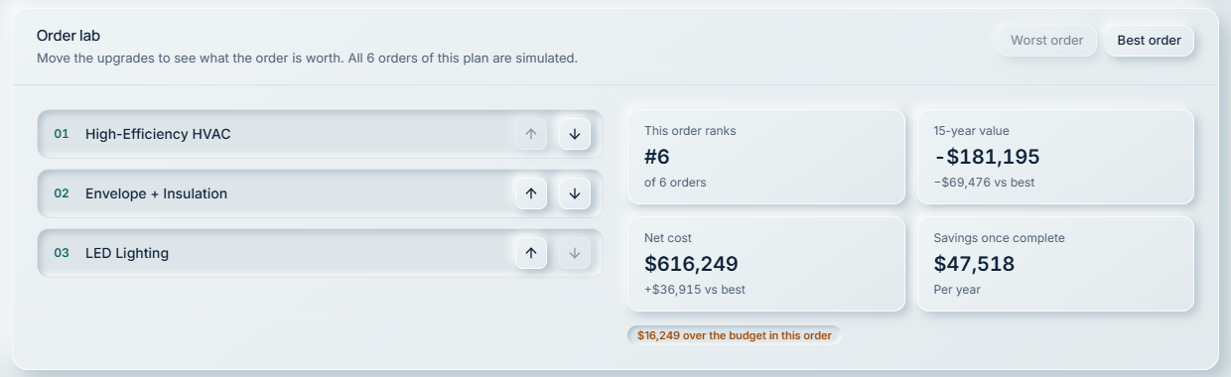
Backup: the Order Lab on the worst order
Notes:
Hidden slide, for when the internet fails during the live demo. Type 8 and press Enter to go back to the talk.

